Slide 1
X. Low energy electron diffraction (LEED)
10-1. 2-dimensional surface structures
Bulk: 14 Bravais lattices
Surface: 5 surface lattices
----- describe all possible periodic
surface structures
----- Miller index
----- structure = lattice point + basis
----- derivation by symmetry

Slide 2
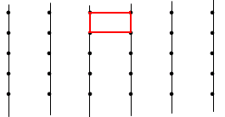
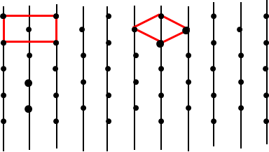
(a) Rectangular lattice (a ≠ b, γ = 90º)
(b) Centered rectangular lattice (a ≠ b, γ = 90º)

Slide 3
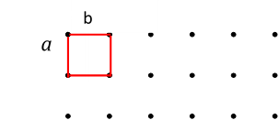
(c) Parallelogram (oblique) lattice (a ≠ b, γ ≠ 90º)
(d) square lattice (a = b, γ = 90º)

Slide 4
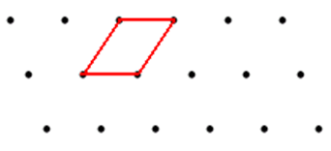
(e) Hexagonal lattice (a = b, γ = 120º)
We have shown that there are only five plane
lattices in Chapter 3-1.
Example:
The ideal Si(111) surface: a hexagonal lattice.
The ideal Si(100) surface: a square lattice.
The (110) surface of Au: a rectangular lattice.
FCC

Slide 5
10-2. Techniques for surface structure
determination
LEED (Low energy electron diffraction)
RHEED (Reflection high energy electron
diffraction)
STM (Scanning tunneling microscope)
SEXAFS (Surface extended X-ray
absorption fine structure)
In this course, LEED and RHEED will be
covered.

Slide 6
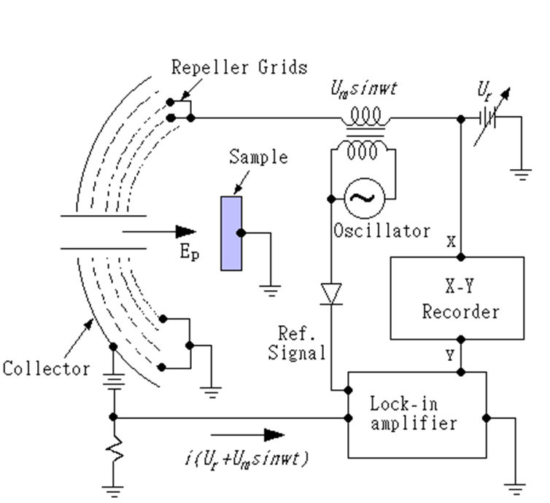
4-grids LEED optics

Slide 7
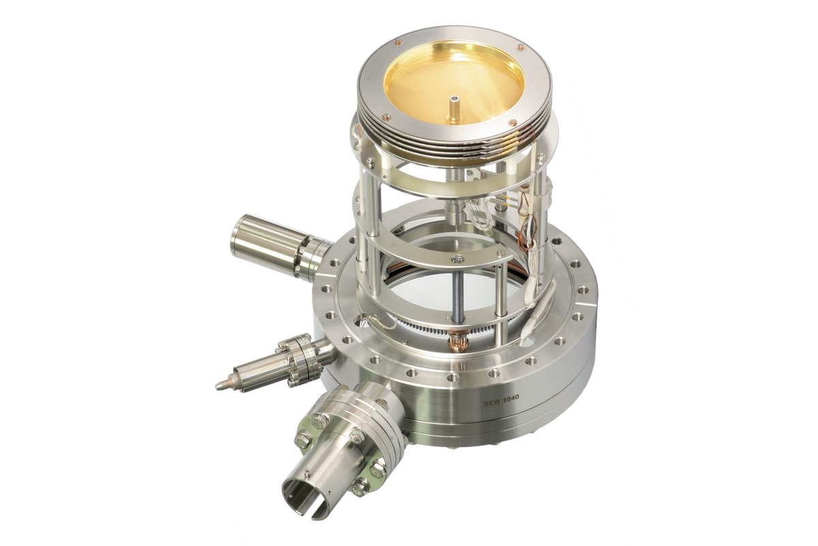
http://www.omicron.de/cache/media_GB_IMG_0093C_freigestellt%5B2467%5D_20111208-122653_omicronmedia_image_paddedthumbnailscheme_ffffff_800x1200.jpg

Slide 8
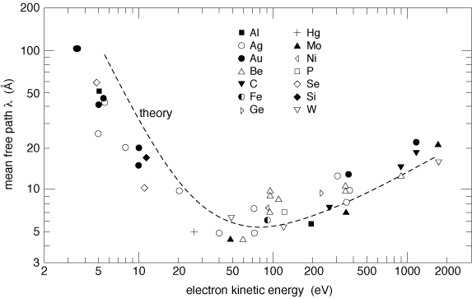
Electron escape depth and surface sensitivity
http://www.globalsino.com/micro/TEM/images/TEM9923.gif

Slide 9
The reciprocal lattice of the surface in LEED
Total scattering amplitude F for LEED is
: the electron density in the volume that
electrons are scattered and collected in the
detector (screen).

Slide 10
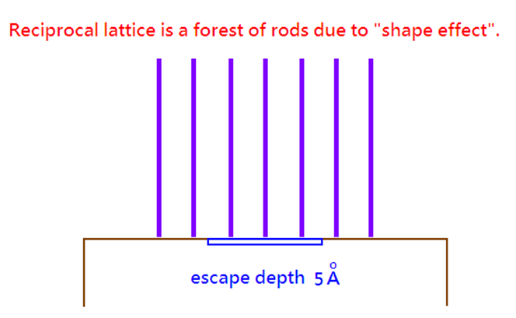
In LEED, electrons are diffracted from volume within electron escape depth. If the electron beam size is 100 nm and the escape depth is 0.5 nm, the volume is in a disk shape.

Slide 11
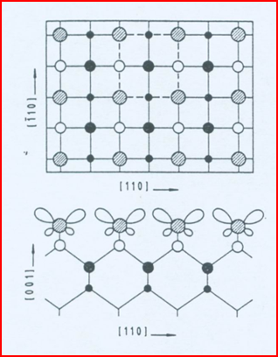
10-3. Ewald sphere construction the Si(100)
ideal surface in LEED
The atomic structure of the Si(100) ideal
surface
-110
110

Slide 12
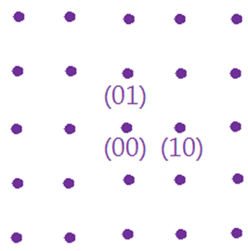
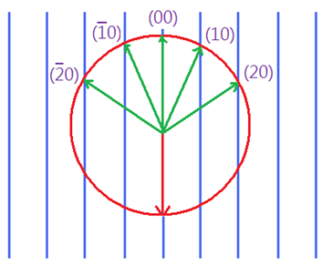
Ewald sphere construction and the expected LEED pattern

Slide 13
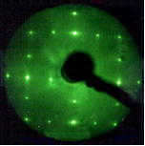
However, the LEED pattern of as-cleaned Si(100) is not a square lattice
The LEED pattern for the Si(100) surface cleaned at 950$℃$ is double domain Si(100)-2x1 shown below, rather than Si(100)1x1

Slide 14
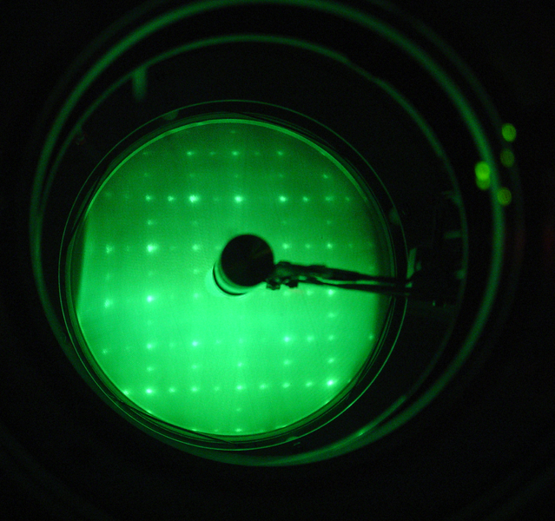
Explain this pattern later!
http://upload.wikimedia.org/wikipedia/en/thumb/c/c4/Si100Reconstructed.png/639px-Si100Reconstructed.png

Slide 15
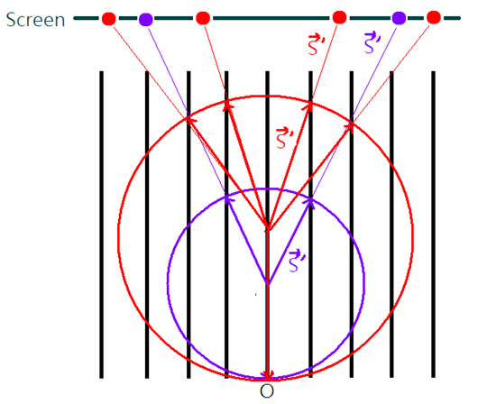
> LEED using different electron kinetic energies
10
10
2θ_{B}
< 2θ_{B}
kinetic energy of electron increases ↑
k ↑ radius of Ewald sphere ↑
→ diffracted spots move inwards the sreeen

Slide 16
Low E
High E

Slide 17
III. Surface reconstruction (defined in the real
space)
(a) For a reconstructed surface
Wood’s notation
Where M is the chemical element, (hkl) is the plane, Rθ is the rotation θ angle between the axes of surface and bulk

Slide 18
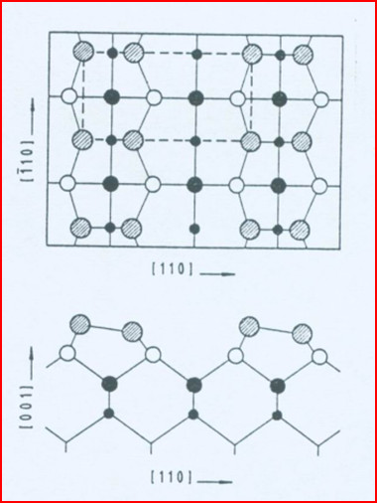
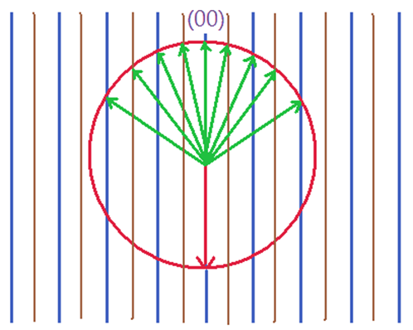
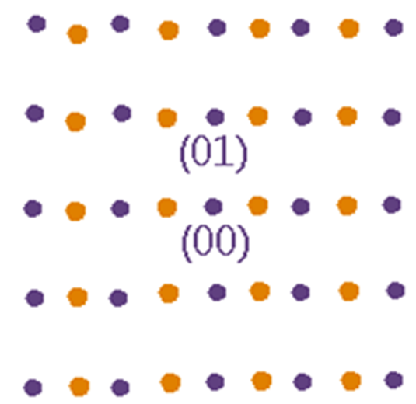
For example: Si(100)2x1
LEED pattern of single domain Si(100)2x1

Slide 19
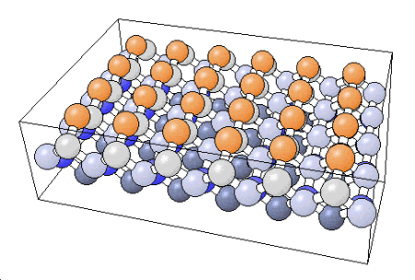
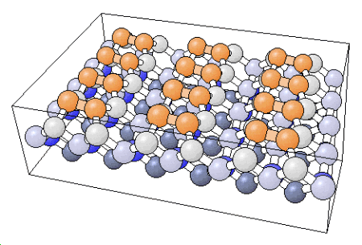
http://www.chem.qmul.ac.uk/surfaces/scc/scat1_6a.htm

Slide 20
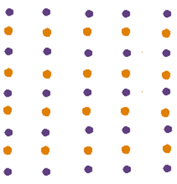
Another domain
Supposition of two domain →
double domain of Si(100)2x1

Slide 21
Si(111) surface reconstructions and their LEED patterns
Question
What are the reciprocal lattices of the Si(111)1x1, Si(111)2x1, and Si(111)7x7 surfaces?
What are the LEED patterns of the Si(111)1x1, Si(111)2x1, and Si(111)7x7 surfaces?

Slide 22
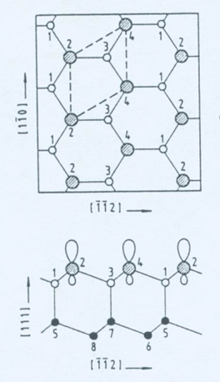
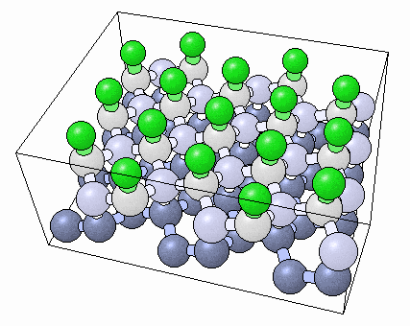
Picture from the NIST Surface Structure Database
Si(111)1x1
http://www.fhi-berlin.mpg.de/KHsoftware/Balsac/BalsacPictures/SSDfig99.gif

Slide 23
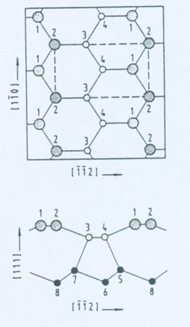
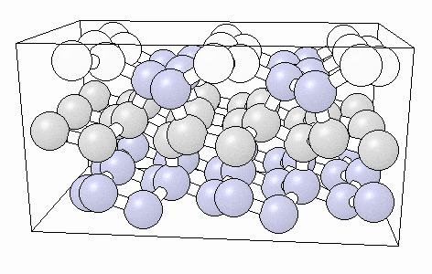
Si(111)2x1
http://www.fhi-berlin.mpg.de/KHsoftware/Balsac/BalsacPictures/SSDfig89.gif

Slide 24
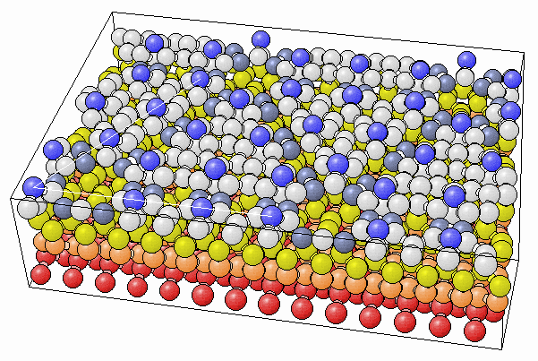
Si(111)7x7
http://www.fhi-berlin.mpg.de/KHsoftware/Balsac/BalsacPictures/SSDfig91.gif

Slide 25
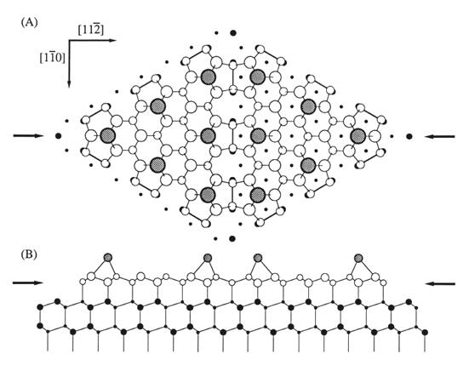
http://www.geocities.jp/mitoh6/das7x701.jpg

Slide 26
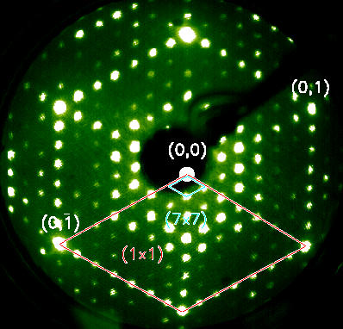
http://www.desy.de/~hasunihh/poster/beug/img1.jpg

Slide 27
Practice for wood’s notation:
http://www.chem.qmul.ac.uk/surfaces/scc/scat6_4.htm
http://www.chem.qmul.ac.uk/surfaces/scc/scat6_1.htm

Slide 28
100
1x2

Slide 29
100
110
2x2
2x2

Slide 30
100
110
c2x2
c2x2

Slide 31
Substrate:
fcc (111)
Substrate unit cell
2x2
Surface or abrorbate unit cell

Slide 32
Substrate:
fcc (111)

Slide 33
10-5. Adsorbate surface structure
For an adsorbate surface
Where M is the chemical element, (hkl) is the plane, Rθ is the rotation θ angle between the axes of surface and bulk, and A is the adsorbate.

Slide 34
Example #1 Ni(110)-C2x2-O

Slide 35
Example #2 Coadsorption
2x2

